Slide 1
DIGITAL IMAGE PROCESSING
Image Compression

Slide 2
Image Compression
Need for data (not information) compression
Data compression aims to reduce the amount of data needed for conveying some information
Variable amount of data can be used to deliver the same piece of information
Identification of data-redundancy
🞑 Given two data sets, representing the same information with n1 and n2 data units
🞑 The relative data redundancy can be worked out as:
1
R = 1 −
If n1=10, n2=1 then Cr=10:1 or 10
Rd=0.9 indicating that 90% data is redundant in the uncompressed data set
D
C
R
C
₌ n₁
R
n₂

Slide 3
Image Compression
The two dimensional representation of information (image) exhibit the following types of redundancies:
🞑 Coding redundancy
The 8-bit codes used to represent intensity information contain more bits
than needed to represent the same information
🞑 Interpixel/spatial/temporal redundancy
Pixels are correlated in the spatial domain, each pixel is mostly similar to its neighbour. Information is unnecessary replicated
🞑 Psychovisual redundancy
Most of the 2-D arrays contain information that is ignored by the human visual system and thus extraneous to the intended use of image – redundant in the sense that it is not used by the visual system

Slide 4

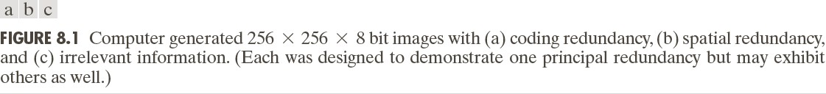
Image Compression
Compression is achieved when one or more of these redundancies is reduced or eliminated

Slide 5
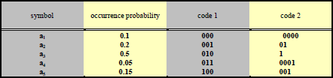
Coding redundancy
Deals with the representation of information, i.e., coding itself.
◻Obvious: L _{avg,1} = 3 .
^{◻L} avg,2
can be calculated as follows.
◻4x0.1 + 2 x0.2 + 1x0.5 + 4x0.05 + 3x0.15 = 1.95 bits/symbol.
◻=> for the same set of symbols, different codes may perform differently. Code 1 contains some redundancy.

Slide 6
Coding redundancy
Higher probability of occurrence → shorter codes (vice versa)
Suppose an image has
r_{k}
number of gray levels
r_{k}
n_{k}
If each of the gray levels occurs
times out of the total
‘n’ pixels in the image
r
p (r ) =
n
Then the probability of occurrence of each
is:
k
k
k k
n
k = 0,1,2,.....L −1
If the number of bits used to represent each
r_{k}
is l(r_{k} )
L−1
Then the average number of bits: L_{avg}
= ∑l(r_{k} )p(r_{k} )
k =0
Total number of bits required to represent MxN image=MNL_{avg}
The aim is to reduce the average value by using variable-length coding

Slide 7

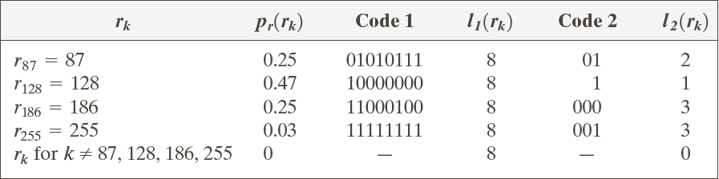
Coding redundancy
L_{avg} =0.25(2)+0.47(1)+0.25(3)+0.03(3)=1.81 bits
The total number of bits required to represent the MxN (256x256) image would be=MNL_{avg} =256x256x1.81=118621 bits
_{C =} 256x256x8 ₌ 8 _{= 4.42} 118621 1.81
And
R = 1 − ¹ = 0.774 4.42
Thus 77.4% of the data in the original 2-D image is redundant

Slide 8
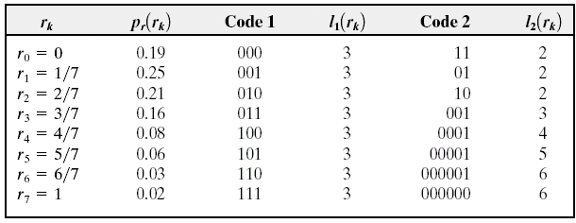
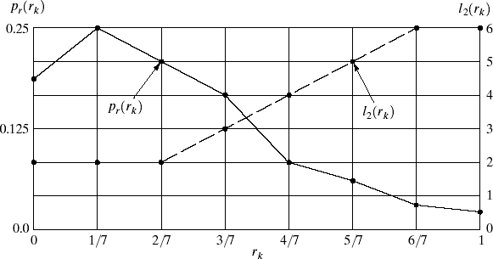
Coding redundancy
L−1
◻ Need
= ∑l(r_{k} )p(r_{k} )
^{L}avg
k =0
L_{avg}=2(0.19)+2(0.25)+2(0.21)+3(0.16
)+ 4(0.08)+5(0.06)+6(0.03)+6(0.02)
L_{avg}=2.7 bits
Code1 to Code2 compression ratio
C_{R} =3/2.7=1.11
10% data in code1 is redundant

Slide 9
Measuring Image Information
Compression is all about reducing the amount of data units required for representation of image information
How few bits are actually needed to represent the
information in an image?
Is there a minimum limit of data units that can be used to represent an image without loosing information?

Slide 10
Measuring Image Information
A random event E with probability P(E) is said to contain:
I (E) = log
1
= −log P(E)
Units of information
P(E)
If P(E)=1 it implies that the event always occurs and I(E)=0
Because no uncertainty is associated with the event, and thus no information would be transferred when the event has occurred, it always occurs (nothing unusual)
The base of the logarithm determines the units used to measure the information
For base 2 the units of information is the bit
If P(E)=1/2, then I(E)=-log₂1/2, or 1 bit
That is 1 bit is required to convey the information when one of the two possible events occur

Slide 11
Measuring Image Information
Given a source of statistically independent random events from
a discrete set of possible events:
{a₁ , a₂ ,...., aj}
With associated probabilities: {P(a1 ), P(a2 ),...., P(aj)}
The average information per source output (event/pixel (gray scale) value) is called entropy of the source:
H = −∑ P(a_{j} ) log P(a_{j} )
j =1
J

Slide 12
Measuring Image Information
Given a source of statistically independent random events from
a discrete set of possible events:
{a₁ , a₂ ,...., aj}
With associated probabilities: {P(a1 ), P(a2 ),...., P(aj)}
The average information per source output (event/pixel (gray scale) value) is called entropy of the source:
H = −∑ P(a_{j} ) log P(a_{j} )
j =1
J
For an image, the entropy becomes:
H = −∑ P_{r} (r_{k} ) log ₂ P_{r} (r_{k} )
k =0
L−1

Slide 13
Measuring Image Information
The entropy of the image:
H = −[0.25log ₂ 0.25 + 0.47 log ₂ 0.47 + 0.25log ₂ 0.25 + 0.03log ₂ 0.03]
H = −[0.25(−2) + 0.47(−1.09) + 0.25(−2) + 0.03(−5.06)]
H = 1.66 bits/pixel

Slide 14
Huffman coding
Huffman coding assigns an output code to each symbol with the output codes being as short as 1 bit, or considerably longer than the input symbols, depending on their probability
The optimal number of bits used for each symbol is - log₂ p, where p is the probability of a given symbol.
The assigned code words have to consist of an integral number of bits, this makes Huffman coding suboptimum.
For example, if the probability of a symbol is 0.33, the optimum number of bits to code that symbol is around 1.6 bits, but the Huffman coding scheme has to assign either one or two bits to the code. In either case, on average it will lead to more bits compared to its entropy.
🞑 As the probability of a symbol becomes very high, Huffman coding becomes very non-optimal.
For example, for a symbol with a probability of 0.9, the optimal code size should be 0.15 bits, but Huffman coding assigns a minimum value of one bit code to the symbol, which is six times larger than necessary.

Slide 15
Huffman coding steps
Huffman coding steps
Step-1: Rank all the symbols in the order of their probability of
occurrence
Step-2: Successively merge every two symbols with the least probability to form a new composite symbol, and rerank order them; this will generate a tree, where each node is the probability of all nodes beneath it
Step-3: Trace a path to each leaf, noting the direction at each node.

Slide 16
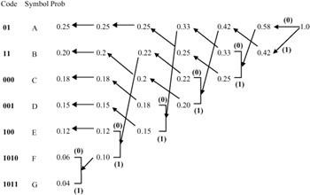

Huffman coding example
Example:
The average bit per symbol is then:
0.25 × 2 + 0.20×2 + 0.18×3 + 0.15×3 + 0.12×3 + 0.06×4 + 0.04×4 =
2.65 bits
which is very close to the entropy given by:

Slide 17
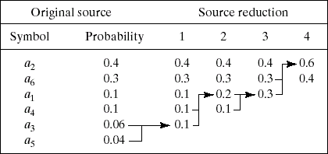
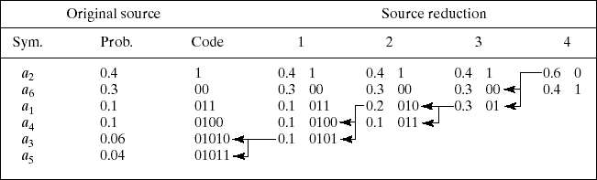
Huffman Coding

Slide 18
Huffman Coding
Calculate the Compression ratio
Workout the percentage of data redundancy in the compressed and decompressed in the two data sets

Slide 19
Psychovisual Redundancy
🞑 Originates from the characteristics of the human visual system (HVS).
🞑 Visual information not perceived equally by HVS.
🞑 If apply less data to represent less important visual information, perception will not be affected.
🞑 In this sense, some visual information is psychovisually redundant.
🞑 Eliminating psychovisual redundancy leads to data compression.

Slide 20
Fidelity Criteria
When information loss can be expressed as a mathematical function of the input and output of a compression process, it is said to be based on an objective fidelity criteria
Let
Let,
f (x, y)
^
f (x, y)
be an input image
be an approximation of f(x,y) after the input is
compressed and then decompressed
^
The error e(x,y) is given by: e(x, y) = f (x, y) − f (x, y)
The total error between the two images is:
M −1 N −1 ⎡ ^
⎤
∑∑
f (x, y) − f (x, y)
⎢
⎥
x=0 y=0
⎣
⎦
The signal to noise ratio of the output is given by:
M −1 N −1 ⎡ ^
⎤ 2
∑∑
x=0 y=0
f (x, y)
⎢
⎥
SNR =
⎣ ⎦
M −1 N −1 ⎡ ^
⎤ 2
∑∑
x=0 y =0
f (x, y) − f (x, y)
⎢
⎥
⎣
⎦

Slide 21
Interpixel Redundancy
In digital images, there is a high correlation among neighbouring pixels
Due to this correlation the pixel values of any given pixel can be predicted from the values of its neighbours
Simply put, most of the visual contribution of a single pixel to an image is redundant
It can be guessed from the values of its neighbours
Removal of such redundancies involves the conversion of an image to a non-visual format
Such mappings reduces the data-units required for conveying the overall image information

Slide 22
Arithmetic Coding
Arithmetic coding completely bypasses the idea of replacing an input symbol with a specific code (unlike Huffman Coding)
Instead, it takes a stream of input symbols and replaces it with a single floating point output number
The longer (and more complex) the message, the more bits are needed in the output number
The output from an arithmetic coding process is a single
number less than 1 and greater than or equal to 0
This single number can be uniquely decoded to create the exact stream of symbols that went into its construction
In order to construct the output number, the symbols being encoded have to have a set probabilities assigned to them

Slide 23
Arithmetic coding Example …
A fixed model arithmetic code is used in the example
Symbol | Probability | Range
a | 0.2 | [0.0, 0.2)
e | 0.3 | [0.2, 0.5)
i | 0.1 | [0.5, 0.6)
o | 0.2 | [0.6, 0.8)
u | 0.1 | [0.8, 0.9)
! | 0.1 | [0.9, 1.0)

Slide 24
AC Example …
The most significant portion of an arithmetic coded message is the first symbol to be encoded. Using an example that a message eaii! is to be coded, the first symbol to be coded is e. Hence, the final coded message has to be a number greater than or equal to 0.2 and less than 0.5
Each new symbol to be encoded will further restrict the possible range of the output number during the rest of the encoding process.

Slide 25
Representation of arithmetic coding process
 | New character | Range
Initially: |  | [0, 1)
After seeing a symbol: | e | [0.2, 0.5)
 | a | [0.2, 0.26)
 | i | [0.23, 0.236)
 | i | [0.233, 0.2336)
 | ! | [0.23354, 0.2336)

Slide 26
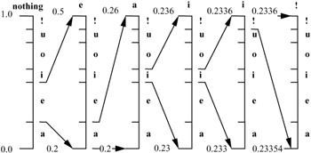
another representation of the encoding process
The final range, [0.23354, 0.2336) represents the message eaii!. This means that if we transmit any number in the range of 0.23354 ≤ x < 0.2336, that number represents the whole message of eaii!

Slide 27
Arithmetic decoding
Suppose a number x = 0.23355 in the range of 0.23354 ≤ x < 0.2336 is
transmitted
Starting with the initial interval [0, 1), only the interval [0.2, 0.5) of e envelops the transmitted code of 0.23355. So the first symbol can only be e.
The symbol intervals are then defined in the new interval [0.2, 0.5) , the new code will be (0.23355 - 0.2)/(0.5 - 0.2) = 0.11185, which is enveloped by the interval [0.0, 0.2) of symbol a.
To find third symbol, a new code within the range of a should be found, i.e. (0.11185 - 0.0)/(0.2 - 0.0) = 0.55925. This code is enveloped by the range of [0.5, 0.6) of symbol i
The resulting new code after decoding the third symbol will be (0.55925 -
0.5)/(0.6 - 0.5) = 0.5925, which is again in [0.5, 0.6).
Repeating this procedure will yield a new code of (0.5925 - 0.5)/(0.6 - 0.5)
= 0.925. This code is enveloped by [0.9, 1), which decodes symbol !, the end of decoding symbol, and the decoding process is terminated

Slide 28
Representation of decoding process of arithmetic coding
Encoded number | Output symbol | Range
0.23355 | e | [0.2, 0.5)
0.11185 | a | [0.0, 0.2)
0.55925 | i | [0.5, 0.6)
0.59250 | i | [0.5, 0.6)
0.92500 | ! | [0.9, 1.0)

Slide 29
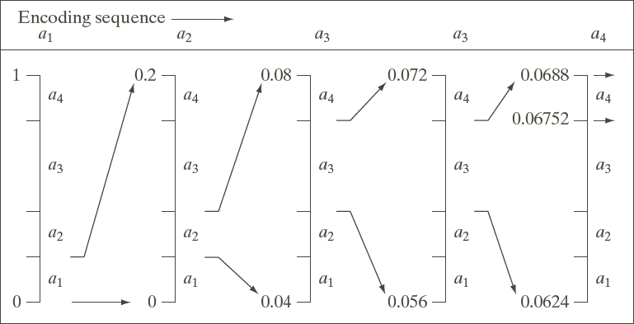
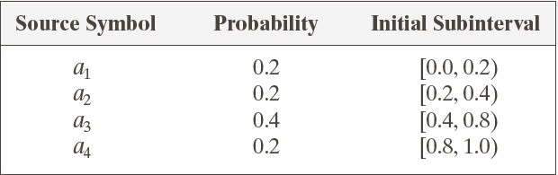
Arithmetic Coding
0.8
0.16
0.072
0.0688
0.4 | 0.08 | 0.056 | 0.0624
0.2 | 0.04 | 0.048 | 0.0592

Slide 30
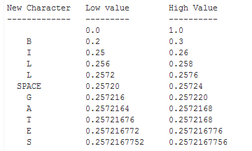
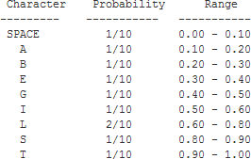
Arithmetic Coding
To encode the random message “BILL GATES”
BILL
GATES
Each character is assigned the portion of the 0-1 range that corresponds to its
probability of appearance
The most significant portion of an arithmetic coded message belongs to the first symbol to be encoded (in this case the range of letter ‘B’)
In order for the first character to be decoded properly, the final coded message has to be a number greater than or equal to 0.20 and less than 0.30.

Slide 31


Arithmetic Coding – the decoding process
To decode the value 0.2572167752 back into “BILL GATES”, we find the first symbol (B) in the message by looking for the symbol that owns the code space that our encoded message falls in
0.2 to 0.3 belonged to B
For the next symbol, subtract the low range of B from the number which will give 0.0572167752
Divide 0.0572167752 by the range of „B‟, which is 0.1 giving:
0.572167752
This new value falls in the range of „I‟ and so on
The decoding is essentially the reversal of the encoding process

Slide 32
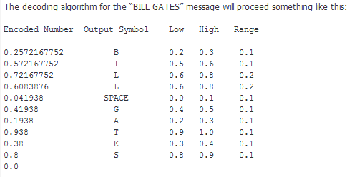
Arithmetic Coding – the decoding process

Slide 33
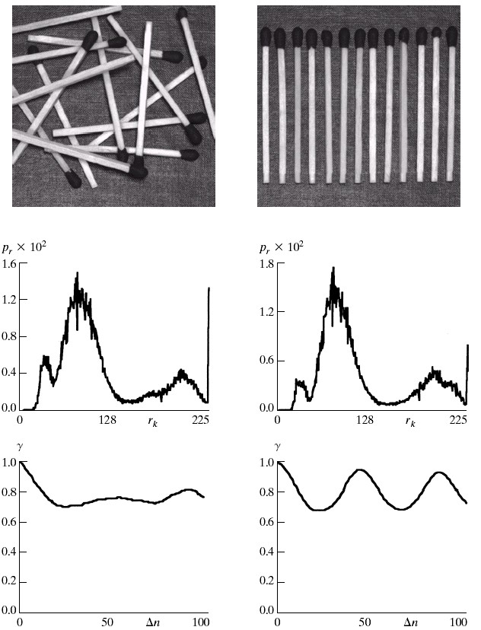
Interpixel Redundancy

Slide 34
DIFFERENTIAL CODING
The differential coding technique encodes the difference between the signal itself and its prediction.
Assume: 8 bits/sample in quantization.
Difference signal: between pixels
Then: dynamic range: from 256 to 512
variance: actually much smaller.

Slide 35
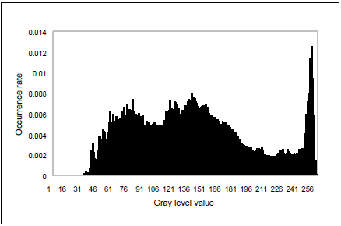
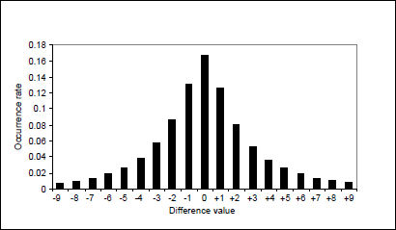
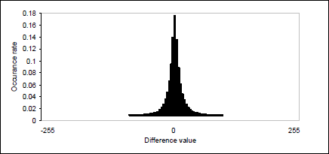
Interpixel Redundancy
“Boy and Girl” image
Histogram of the original “Boy and Girl”
A close-upof the central portion of the
histogram of the difference image.
Histogram of the difference image obtained by using horizontal pixel-to- pixel differencing.

Slide 36
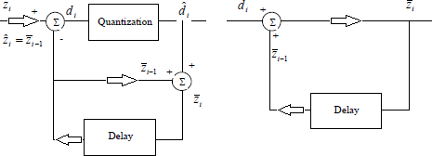
Simple Pixel-to-Pixel DPCM
Block diagram of a practical pixel-to-pixel differential coding system
closed-loop DPCM with feedback around the quantizer
🞑 Prediction error
🞑 Reconstruction error
🞑 Quantization error

Slide 37
Applications
The differential coding technique has played an important role in image coding.
In the international coding standard for still images, JPEG,
🞑 the differential coding is used in lossless mode,
🞑 in DCT-based mode for coding DC coefficients.
In all the international coding standards,
🞑 such as H.261 and H.263, MPEG
🞑 Motion compensated (MC) coding is essentially predictive coding.

Slide 38
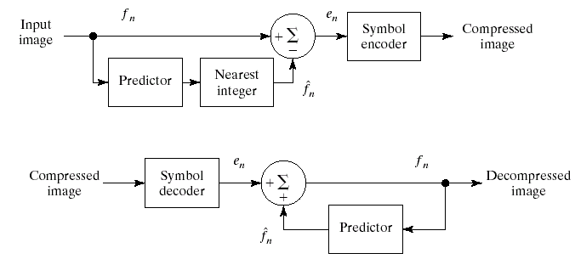
Lossless predictive coding
The aim is to eliminate interpixel redundancies of closely spaced pixels by extracting and coding only the new information in each pixel
These pixels can be coded using Huffman coding
A great deal of interpixel redundancies is removed through the prediction process

Slide 39
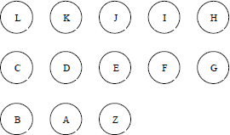
1-D, 2-D and 3-D DPCM
1-D DPCM: use the reconstructed gray level values of more than one preceding pixels within the same scan line to predict that of a pixel being coded.
2-D DPCM: both the decoded intensity values of adjacent pixels within the same scan line and the values of neighboring pixels in the different scan lines are involved in the prediction.
3-D DPCM: neighboring pixels along the time dimension are also involved.

Slide 40
Effect of Transmission Errors
Transmission error caused by channel noise:
reverse the binary bit information from 0 to 1 or 1 to 0 with
what is known as bit error rate.
In case of PCM-coding, each pixel is coded independently of the others. Therefore bit errors does not affect other pixels in the reconstructed image.
In DPCM, however, the effect caused by transmission errors becomes more severe. The transmission error propagates. It is reported that the error propagation is more severe in 1-D differential image coding than in 2-D differential coding.

Slide 41
Transmission Errors
For this reason, the bit error rate required by DPCM coding is lower than that required by PCM coding. For instance, while a bit error rate less than 5×10⁻⁶ is normally required for PCM to provide broadcast TV quality, for the same application a bit error rate less than 10⁻⁷ and 10⁻⁹ are required for DPCM coding
Channel encoding with an error correction capability was applied to lower the bit error rate. For instance, to lower the bit error rate from the order of 10⁻⁶ to the order of 10⁻⁹ for DPCM coding with 1-D prediction, an error correction code by adding 3% redundancy in channel coding has been used

Slide 42
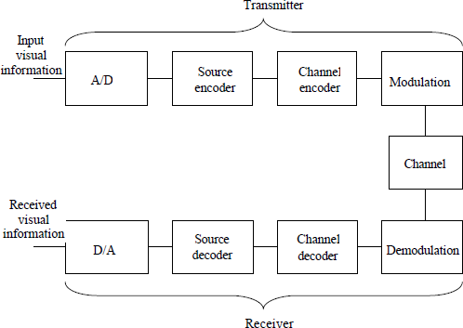
Communication system
◻Block diagram of a visual communication system

Slide 43
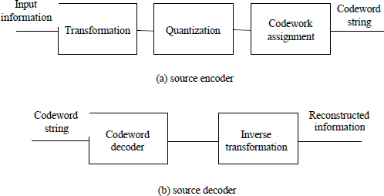
Cont…
◻Block diagram of a source encoder and a source decoder

Slide 44
Quantization
Quantization: an irreversible process.
Quantization: a source of information loss.
Quantization: a critical stage in image and video compression.
It has significant impact on
🞑 the distortion of reconstructed image and video
🞑 the bit rate of the encoder.
Uniform Quantization
🞑 Simplest
🞑 Most popular
🞑 Conceptually, of great importance.

Slide 45
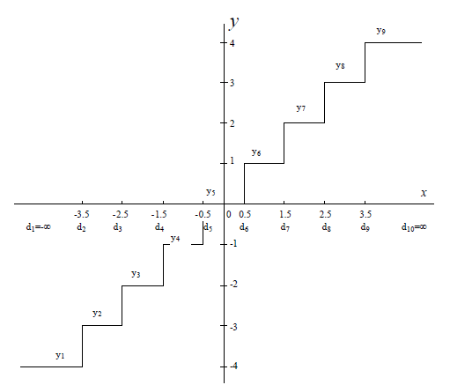
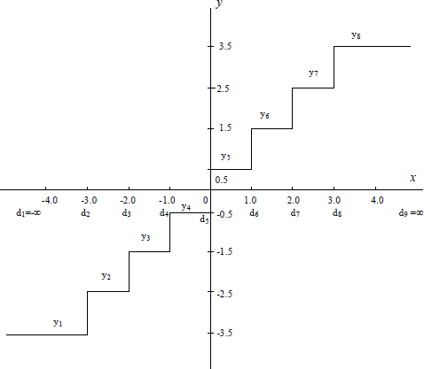
Uniform Quantization
Input-output characteristic of a uniform midtread/ midrise quantizers
where i = 1,2,…,9 and Q(x) is the output of the quantizer with respect to the input x.
Decision levels :
The end points of the intervals, denoted by
d_{i} with i being the index of intervals.
Reconstruction level (quantizing level) :
The output of the quantization, denoted by y_{i}
Step size of the qunatizer:
The length of the interval, denoted by D

Slide 46
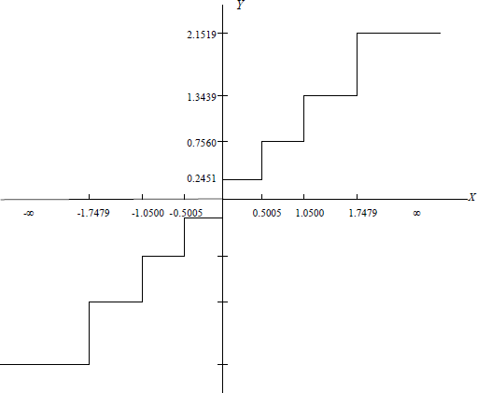
Non-Uniform Quantization
◻Consider an optimum quantizer for
◻a Gaussian distributed input, N=8

Slide 47
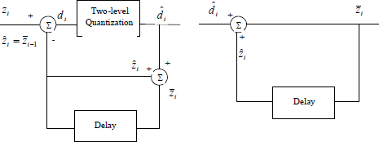

Delta Modulation (DM)
DM is essentially a special type of DPCM
The quantizer is a one-bit quantizer. That is, depending on whether the difference signal is positive or negative, the output is either +▲ /2 or -
▲ / 2.

Slide 48
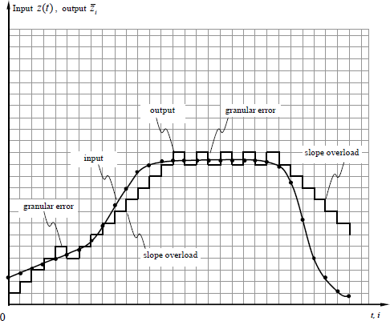
Dm . . .
To improve the performance of DM, an oversampling technique is often applied.
A relatively small step size can be
used so as to decrease the granular noise without increasing the slope overload error.
DM with fixed step size.

